Slide 1
Determination of Soil Stiffness Parameters
Short Course on Computational Geotechnics + Dynamics
Boulder, Colorado
January 5-8, 2004
Stein Sture
Professor of Civil Engineering
University of Colorado at Boulder

Slide 2
Contents
General concepts and stiffness of sand
Hooke’s law
E-moduli from triaxial testing
E-moduli from oedometer testing
Examples on the estimation of E
Stiffness of clays
Undrained clay behavior
Drained clay behavior
Examples on the estimation of E
Computational Geotechnics
Determination of Soil Stiffness Parameters

Slide 3
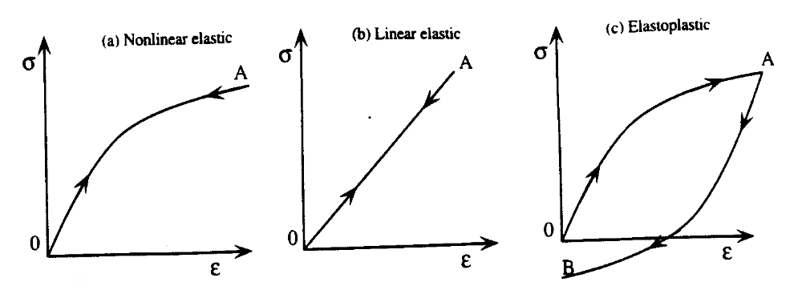
Idealized and real stress-strain behavior of soils
Idealized types of stress-strain behaviors: (a) nonlinear elastic
Model, (b) linear elastic model, and (c) elastoplastic model
Computational Geotechnics
Determination of Soil Stiffness Parameters

Slide 4
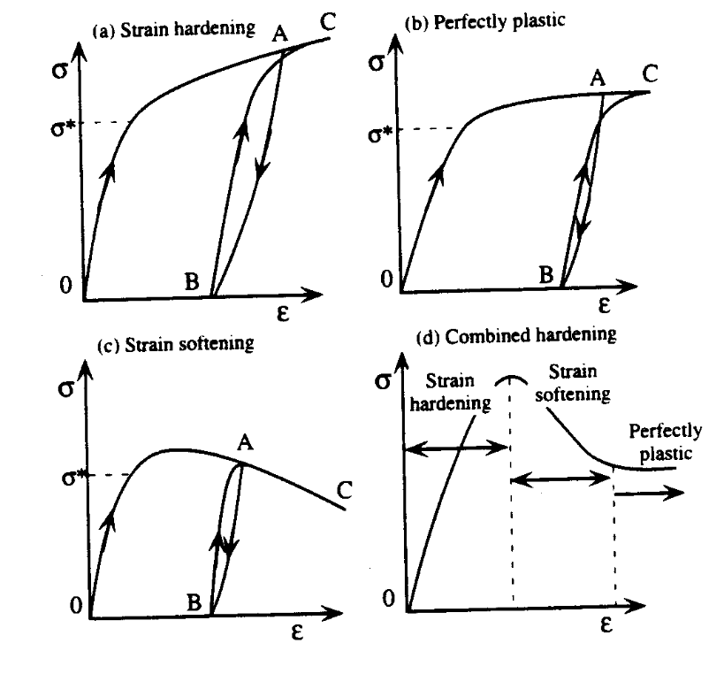
Idealized and real stress-strain behavior of soils
Various types of elastoplastic behaviors: (a) strain hardening, (b) perfectly plastic, (c) strain softening, and (d) combination of a to c.
Computational Geotechnics
Determination of Soil Stiffness Parameters

Slide 5
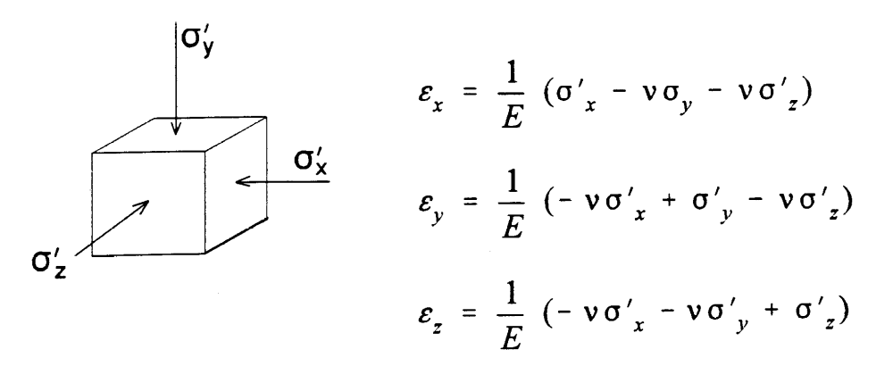
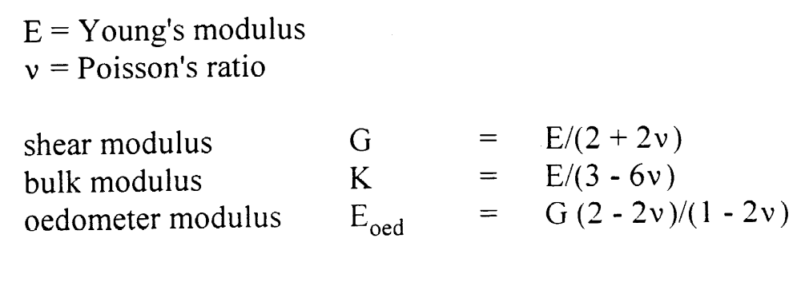
Hooke’s Law of Isotropic Elasticity
Computational Geotechnics
Determination of Soil Stiffness Parameters

Slide 6
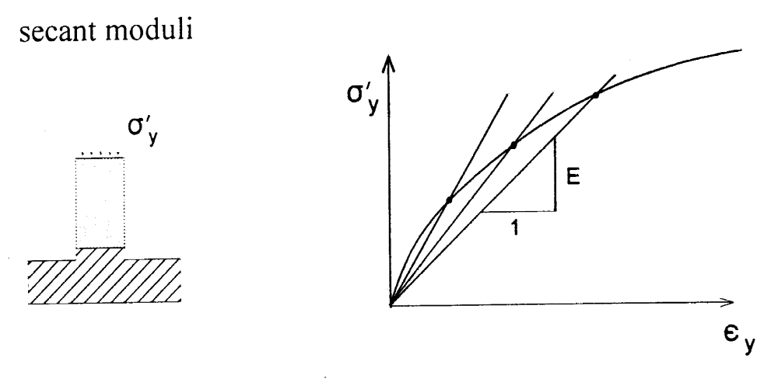
Hooke’s Law of Isotropic Elasticity
Computational Geotechnics
Determination of Soil Stiffness Parameters

Slide 7
Standard Drained Triaxial Test on Sand
Computational Geotechnics
Determination of Soil Stiffness Parameters

Slide 8
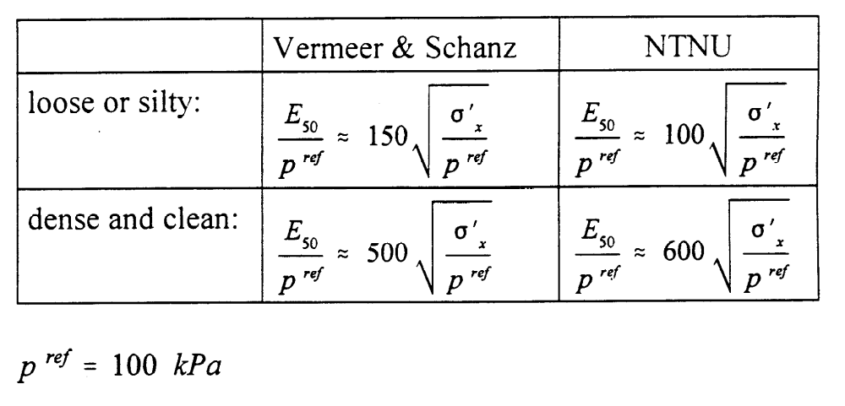
Standard Drained Triaxial Test on Sand
Computational Geotechnics
Determination of Soil Stiffness Parameters

Slide 9
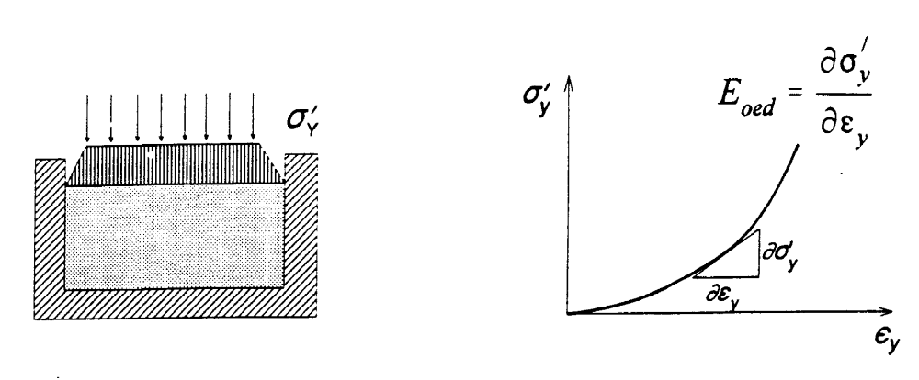
Oedometer Test on Sand
Computational Geotechnics
Determination of Soil Stiffness Parameters

Slide 10
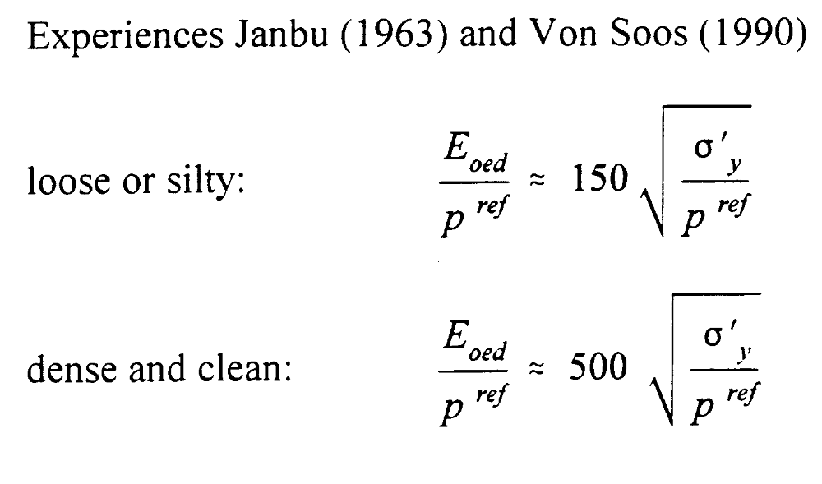
Oedometer Test on Sand
Computational Geotechnics
Determination of Soil Stiffness Parameters

Slide 11
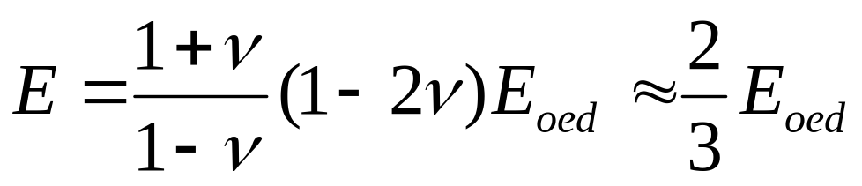
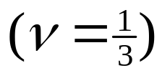
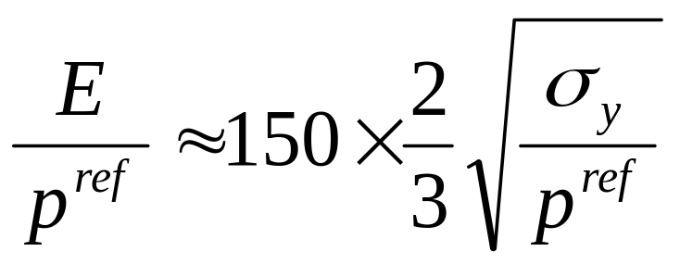
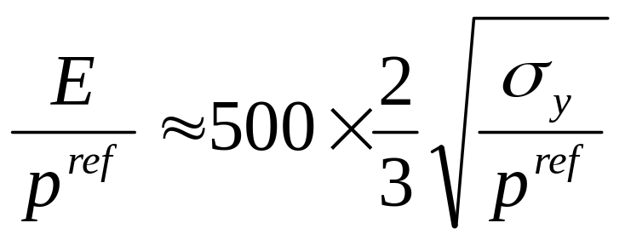
Oedometer Test on Sand
Hooke:
Loose:
Dense:
Computational Geotechnics
Determination of Soil Stiffness Parameters

Slide 12
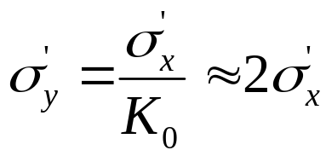
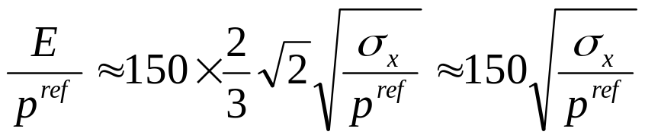
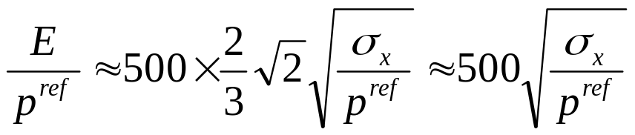
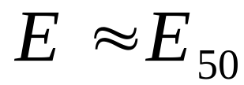
Oedometer Test on Sand
Loose:
Dense:
This implies:
Computational Geotechnics
Determination of Soil Stiffness Parameters

Slide 13
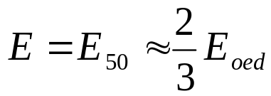

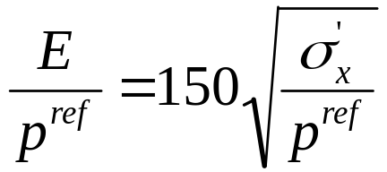
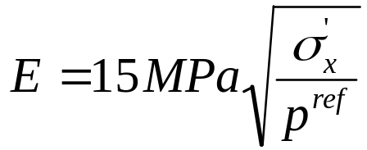
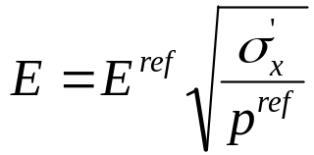
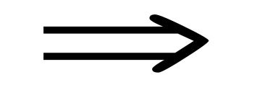
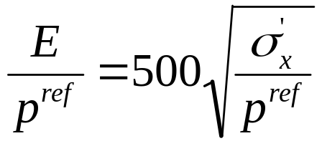
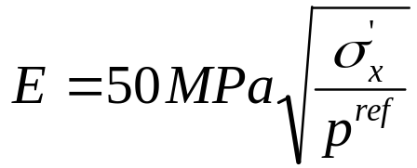

Summary on Stiffness Parameters: Sand
(Laboratory based experience)
Loose:
Loose:
Dense:
Dense:
Unloading: About 4 times stiffer. ν small
Computational Geotechnics
Determination of Soil Stiffness Parameters

Slide 14
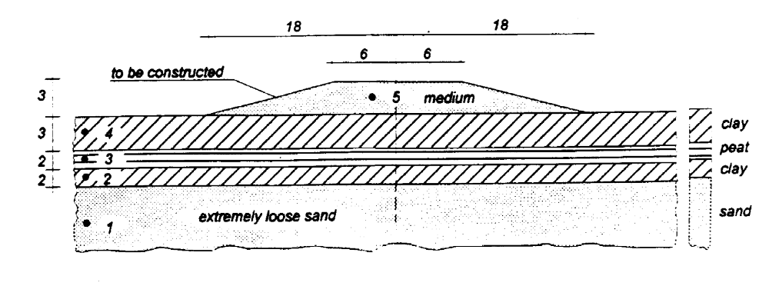

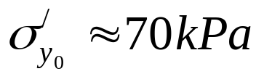

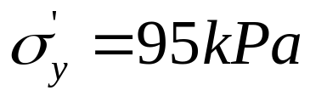
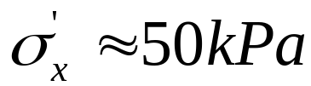
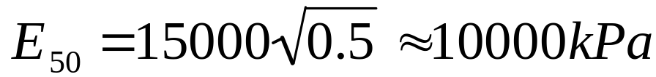
Selection of Moduli for FEM-Computation
Example 1 (loading):
Layer 1 (extremely loose sand
Mohr-Coulomb model:
Layer 1:
Average
Computational Geotechnics
Determination of Soil Stiffness Parameters

Slide 15
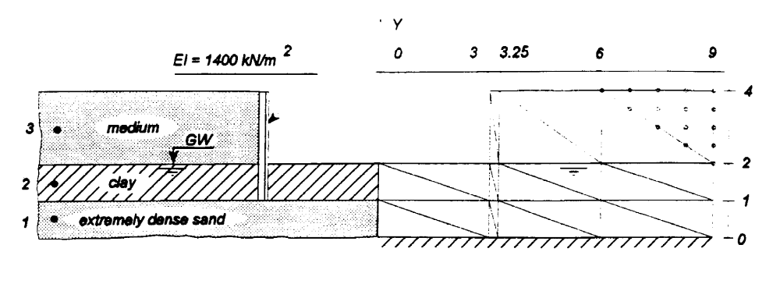








Selection of Moduli for FEM-Computation
Example 2 (unloading):
Layer 1 (dense):
Layer 3 (medium):
Unloading:
for both layers
Mohr-Coulomb model:
Layer 1:
Layer 3:
Computational Geotechnics
Determination of Soil Stiffness Parameters

Slide 16

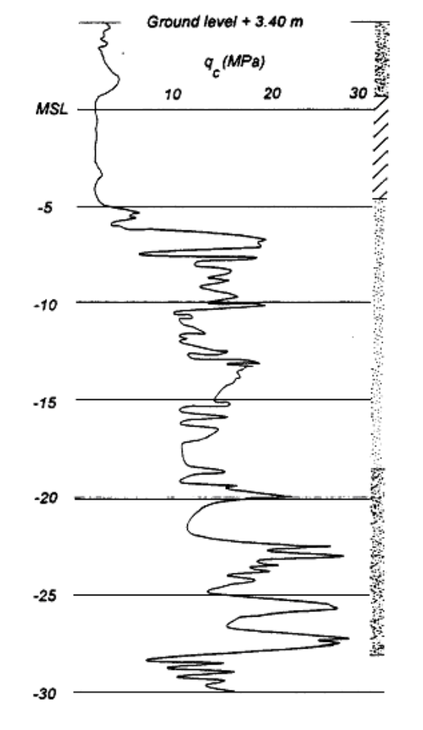

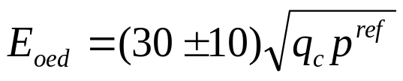
E_{oed} from Cone Penetration Test in Sands
Cone Resistance:
Correlation:
Literature NC-Sand:
α = 1 to 3
Vermeer’s Experience:
α = 3
Alternatively:
Computational Geotechnics
Determination of Soil Stiffness Parameters

Slide 17
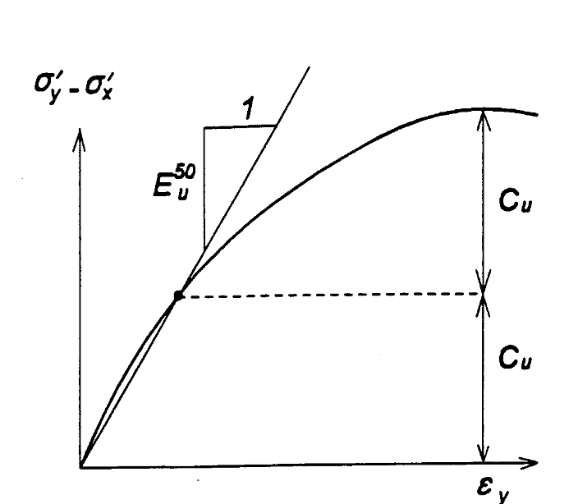
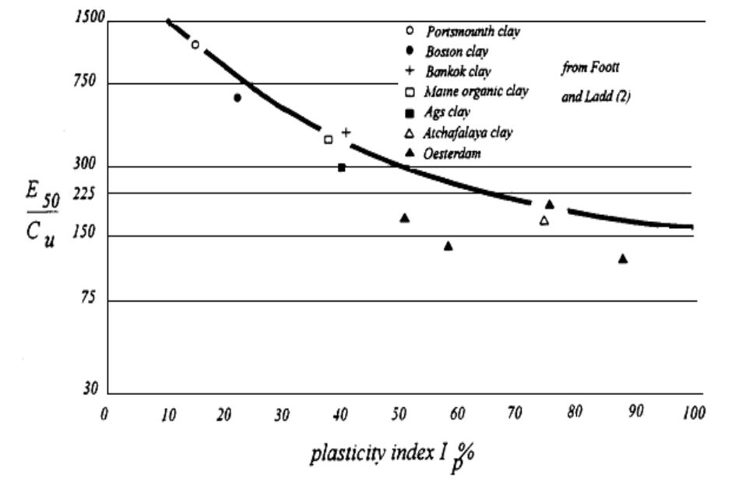
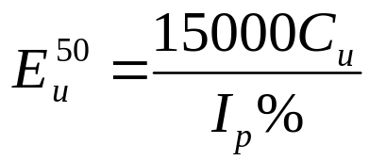

Undrained Triaxial Test on Clay
Normally consolidated clay:
C_{u} = undrained shear strength (or S_{u})
Computational Geotechnics
Determination of Soil Stiffness Parameters

Slide 18
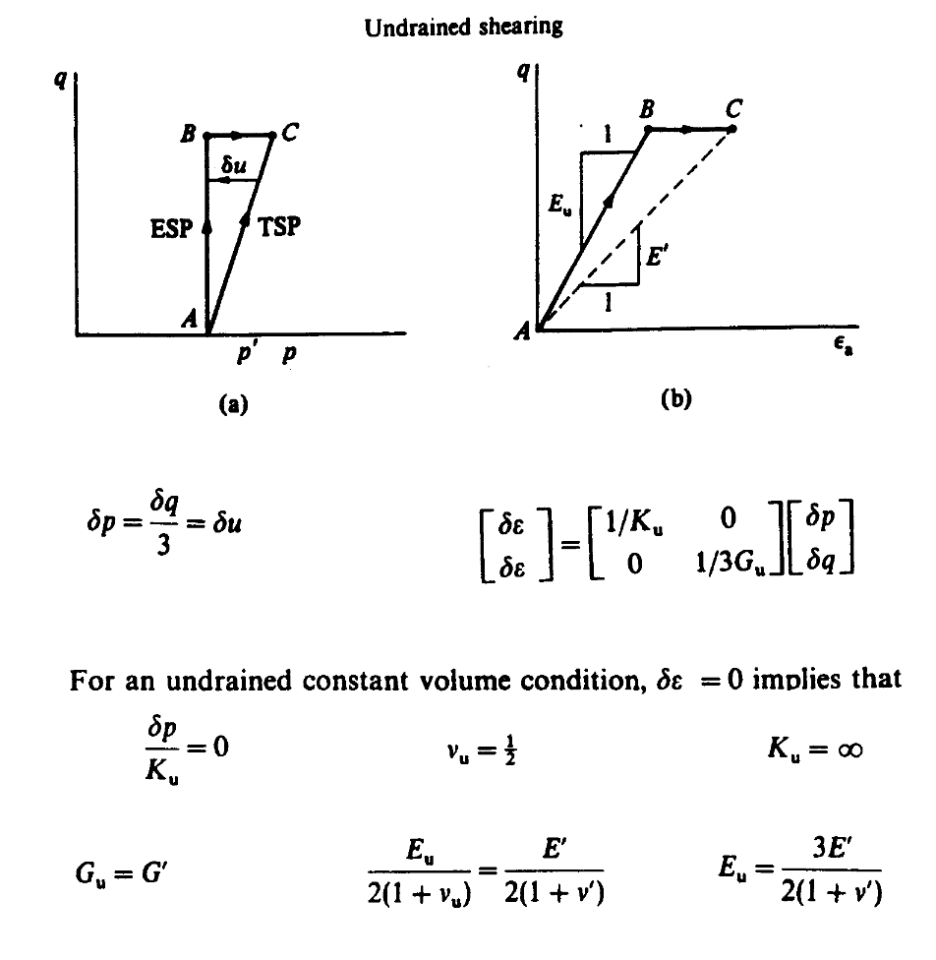
Idealized and real stress-strain behavior of soils
Computational Geotechnics
Determination of Soil Stiffness Parameters

Slide 19
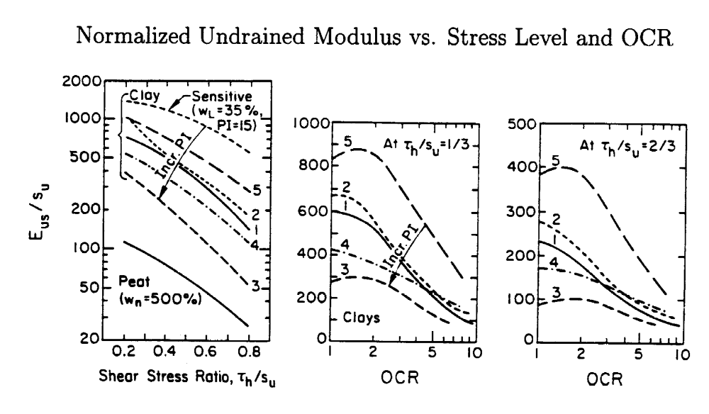
Idealized and real stress-strain behavior of soils
Computational Geotechnics
Determination of Soil Stiffness Parameters

Slide 20
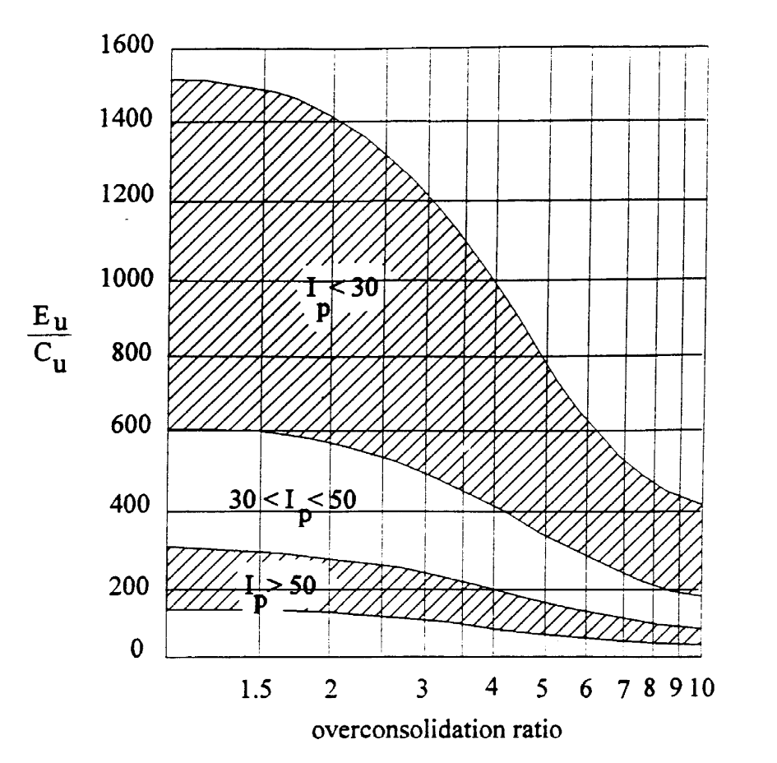
Plate Loading Tests
Duncan & Buchignani (1976)
Computational Geotechnics
Determination of Soil Stiffness Parameters

Slide 21
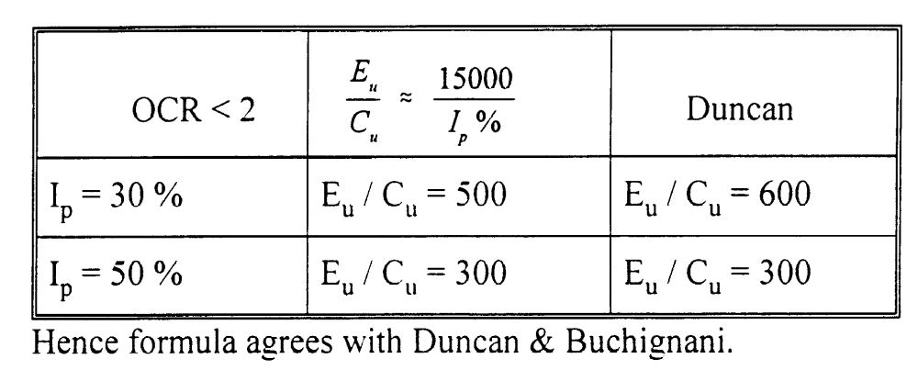
Plate Loading Tests
Computational Geotechnics
Determination of Soil Stiffness Parameters

Slide 22
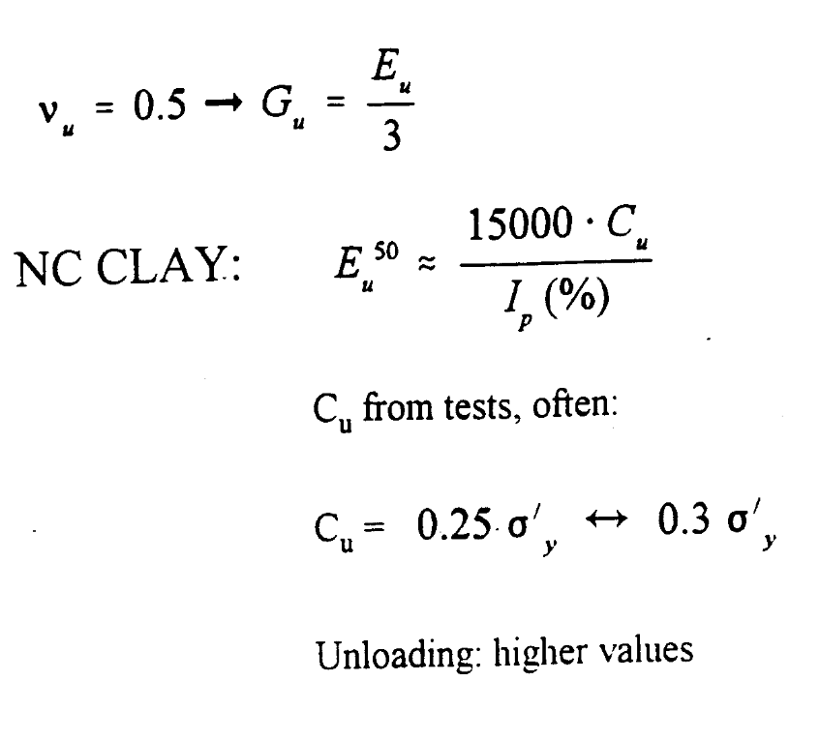
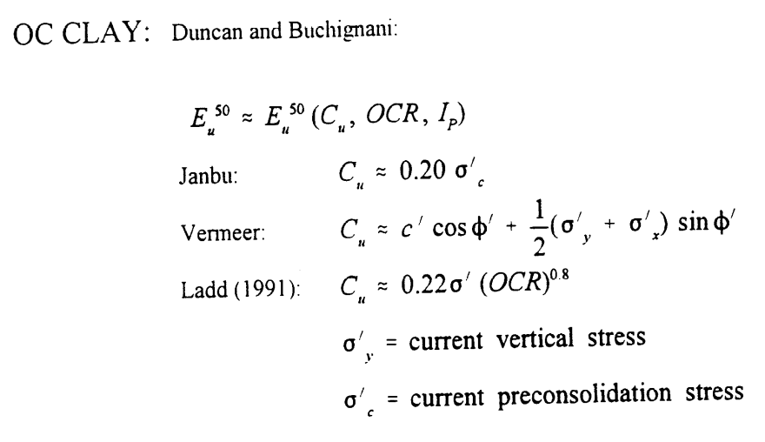
Summary on Stiffness Parameters: Clay
Undrained Conditions
Do not use empirical relationships only. Get good quality experimental data from lab tests, cone penetration tests and vane tests
Computational Geotechnics
Determination of Soil Stiffness Parameters

Slide 23
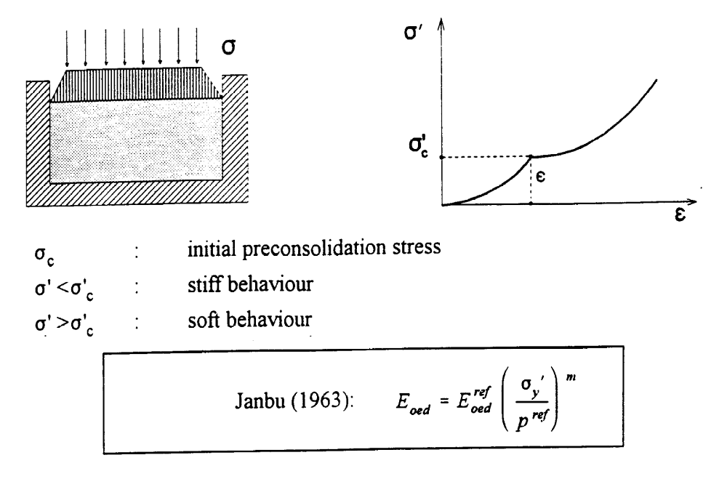
Drained Behavior for Clays
Computational Geotechnics
Determination of Soil Stiffness Parameters

Slide 24
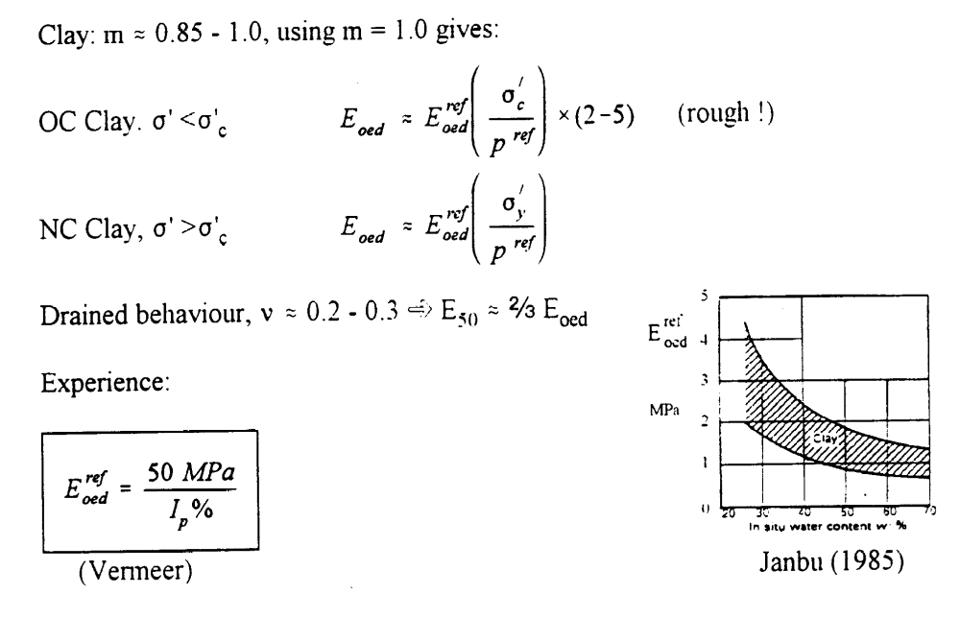
Drained Behavior for Clays
Computational Geotechnics
Determination of Soil Stiffness Parameters

